Slide 1
Health results
File created on: 2/6/24 1:31:52 PM EST

Slide 2


Slide 3


Slide 4
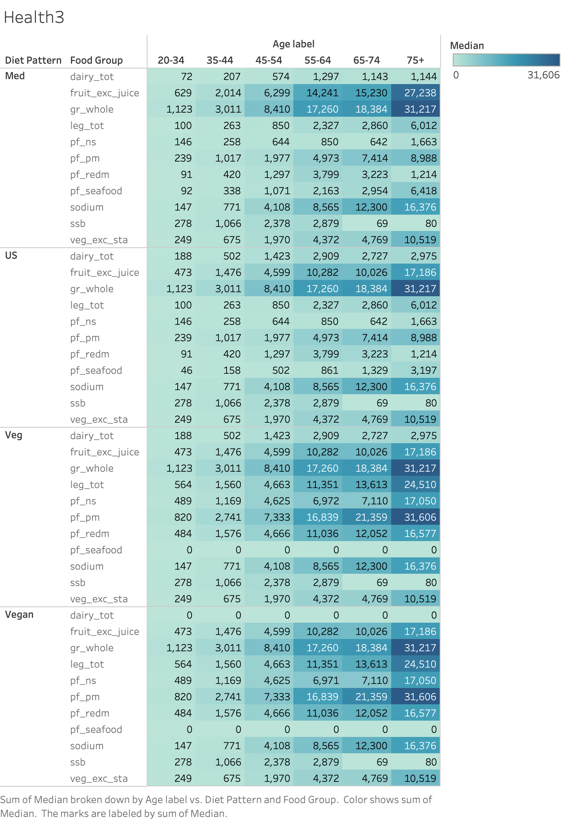

Slide 5
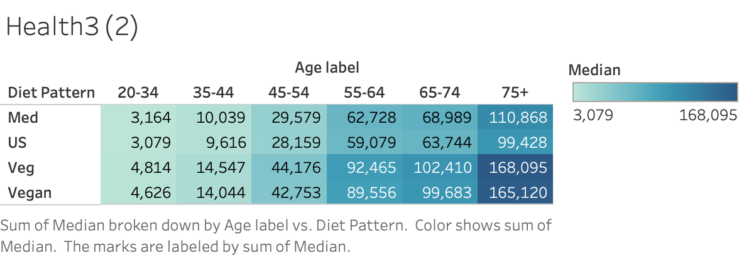

Slide 6
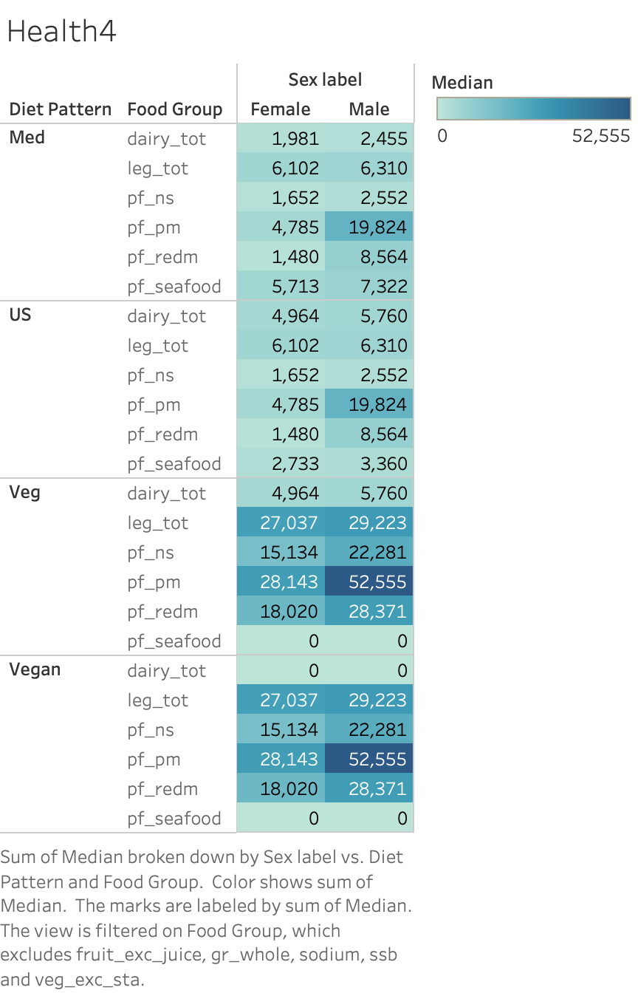

Slide 7
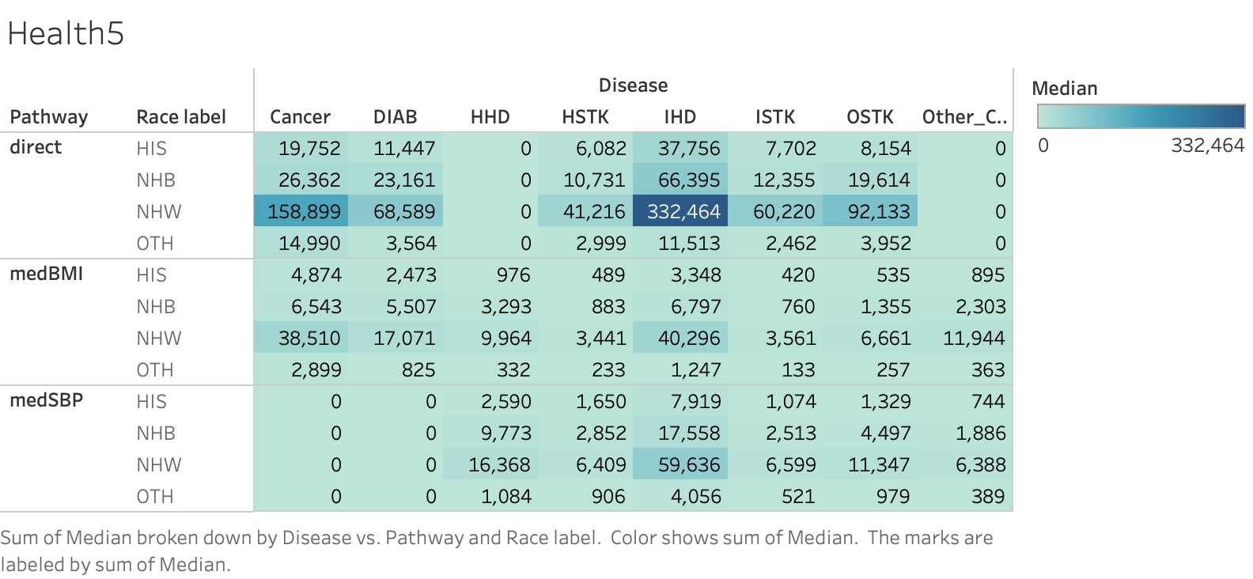

Slide 8
